Slide 1

VIRTUAL INTELLIGENCE DIRECTORATE
OMNIA VINCENT SAPIENTIA
Notian Navy
INTREP VID-OPAR-004
DISCLAIMER:
This is for multiplayer online gaming using the Digital Combat Systems simulation software published by Eagle Dynamics. The information is not in any way suitable for real world use or operations.
Version: 1.0
Published: 2025-01-04

Slide 2
INTRODUCTION
A
A
Aim:
This report intends to present information on Notian Navy structure and task organization while at sea.
Reference:
- INTREP VID B-003 Generic Navy Structure
Content:
Organization
Surface Action Group
Amphibious Task Group
Carrier Strike Group
B
B
C
C
D
D
E
E
F
F

Slide 3

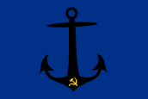
Organization
SRN Navy
10th Missile Ship Division
Pyotr Velikiy
Moskva
20th Anti-submarine Ship Division
40th Carrier Division
50th Supply Ship Division
Moskva
Moskva
30th Amphibious Division
Ropucha
Ropucha
Ropucha
Ropucha
Ropucha
211th Frigate Squadron
212th Frigate Squadron
Rezky
Neustrashimy
Kuznetzov
Rezky
Rezky
Rezky
Rezky
Neustrashimy
Neustrashimy
Neustrashimy
Neustrashimy
511th Tanker Squadron
Elnya
512th Cargo Squadron
Ivanov
Elnya
Elnya
Elnya
Ivanov
Ivanov
Ivanov
Ropucha
Rezky
Neustrashimy
60th Submarine Division
70th Coastal Defense Brigade
80th Amphibious Brigade
711th Coastal Defense Battalion
611th Attack Submarine Squadron
811th Amphibious BN
712th Coastal Defense Battalion
713th Coastal Defense Battalion
714th Coastal Defense Battalion
Kilo
Kilo
Kilo
Kilo
Kilo
Molniya
Molniya
Molniya
812th Amphibious BN
813th Amphibious BN
A
A
B
B
C
C
D
D
E
E
F
F
Back

Slide 4
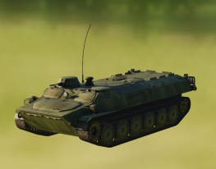
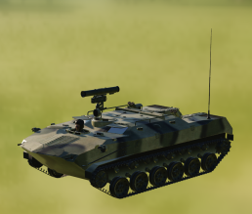
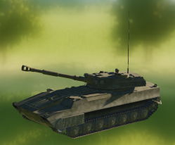
Marine Infantry/Amphibious Brigade
Amphibious
Brigade
TOTAL:
81x APC
27x ARV BTR-RD
18x Arty
= 126 vehicles = 15 Ropucha LST transports to move the Airborne Brigade
Amphibious
Artillery BN
Marine Infantry, The Amphibious Brigade, are used by the Notian Navy for two purposes:
To secure forward key objectives (in a similar way as Airborne brigade are used in the Army).
To provide force protection to Coastal Defense Battalions
The Amphibious Brigade are a light brigade, and for protection against air attack each company have 2x Manpads.
The Amphibious Brigade can organize itself into company amphibious task groups that consist of 9 APC MTLB, 3xAPC BTR-RD and 2x SPH Gvodzika. Combined with a Coastal Defense Battalion, this will fit onto 2x LST Ropuchas.
Amphibious
BN
Amphibious
BN
TOTAL:
27x APC
9x ARV BTR-RD
6x Arty
= 42 vehicles = 5 Ropucha LST transports to move one Airborne Battalion
Amphibious
Anti-tank Company
Amphibious
Artillery Battery
Amphibious
Company
9x vehicles
6x vehicles
27x vehicles
APC MTLB
APC BTR-RD
SPH 2S1 Gvodzika
One Ropucha LST can carry 10-12 vehicles depending on the vehicles size
Back

Slide 5
Doctrine: Surface Action Group (SAG)
A
A
B
B
C
C
FF
D
D
A doctrinal deployment of a basic SAG place a cruiser at the rear and two frigates upthreat to search for enemy submarines. The Cruisers role is to locate and neutralize enemy surface forces, and act as air defence for the SAG.
A Corvette (Molniya) can be placed upthreat to perform the duty as a picket and report on enemy movement
E
E
Threat direction
CG
F
F
FF
Legend:
CV: Carrier (Kuznetzov)
CG: Cruiser (Pyotr Viliky or Mokva)
FF: Frigate (Neustrashimy or Rezky)
LST: Landing Ship Tank (Ropucha)
Back

Slide 6
Doctrine: Carrier Strike Group (CSG)
A
A
B
B
C
C
FF
FF
D
D
A doctrinal deployment of the Carrier Strike Group is to have two frigates upthreat to sanitize the area for enemy submarines. In addition two frigates are covering the rear of the carrier to avoid an ambush. The cruiser are positioned upthreat to act in a air defence and anti surface role to protect the carrier.
Offensive operations are conducted by the carrier based aircraft.
For increased protection, a SAG may be positioned 50nm closer to threat direction to keep the CSG safe.
E
E
Threat direction
CG
CV
F
F
FF
FF
Legend:
CV: Carrier (Kuznetzov)
CG: Cruiser (Pyotr Viliky or Mokva)
FF: Frigate (Neustrashimy or Rezky)
LST: Landing Ship Tank (Ropucha)
Back

Slide 7
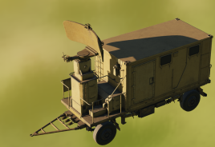
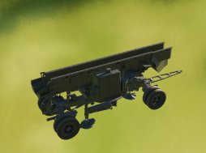
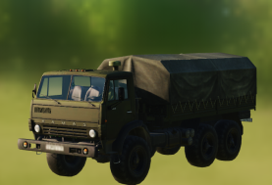
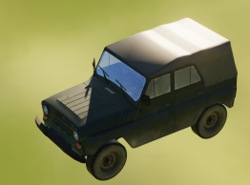
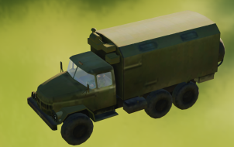
Coastal Defense Brigade
Threat direction
The Coastal Defense units are equipped with SS-N-2 Silkworm missiles that targets surface ships.
The Coastal Defense Brigade consist of 4 Coastal Defense Battalions, which again consist of 2 batteries per battalion.
Each Battalion consist of one search radar and two missile launchers. Each towed by a Kamaz 43101 Truck. In the battery there is a UAZ-469 Jeep and ZIL-131 truck for command and control.
The Coastal Defense units are used to keep enemy ships away from Notian territory.
Radar
Launcher
Launcher
C2
AShM Silkworm SR
AShM SS-N-2 Silkworm
Truck KAMAZ 43101
LUV UAZ-469 Jeep
Truck ZIL-131 (C2)
Back

Slide 8
Doctrine: Amphibious Task Group (ATG)
A
A
B
B
C
C
FF
LST
D
D
A doctrinal deployment of a amphibious task group is to have the frigates upthreat to sanitize the area for enemy submarines. The amphibious ships will be organized close to the cruiser for protection.
As the ampibious ships conduct their assault toward the shore, the Cruiser will provide air defence for the landing operation, and the frigates will operate in anti-submarine operations further out from the shore.
E
E
Threat direction
LST
CG
F
F
LST
FF
Legend:
CV: Carrier (Kuznetzov)
CG: Cruiser (Pyotr Viliky or Mokva)
FF: Frigate (Neustrashimy or Rezky)
LST: Landing Ship Tank (Ropucha)
Back

Slide 9
TTP: Amphibious assault
A
A
A Amphibious assault consist of 5 phases:
Phase 1: Intelligence collection
Normally done by airborne ISR platforms.
This is done 72 hours before landing
Phase 2: Clearance of the area for enemy submarines.
Done by a combination og airborne ASW (Anti Submarine Warfare) aircraft, and ASW capable frigates. This is done 12-48 hours before landing
Phase 3: Isolation of beachead
Done by either A-G flights from the airforce, or airborne landing from airborne forces from the Army. This is done within 12 hours of the landing.
Phase 4: Landing of forces
Ropucha LST put forces ashore. Supported by ships for FP from sea, and to support with naval gunfire toward land.
Phase 5: Resupply
Once forces are on shore, they need to be resupplied with fuel, food and ammunition to be able to continue to operate
B
B
Supports with anti-submarine and anti surface capability
CG
Supports with anti-air capability
FF
C
C
D
D
E
E
F
F
Supports with naval gunfire against land targets
Amphibious Objective Area (AOA)
FF
LST
Coastline
Airborne objective
Roads
DZ
Drop zone
Back

